Slide 1
CIRCUIT AND SYSTEMS
COURSE CODE: ETEE-207
By
Mr. LALIT AGARWAL
ASSISTANT PROFESSOR
EEE, MAIT

Slide 2
LECTURE-12&13

Slide 3
CIRCUIT ANALYSIS BY LAPLACE TRANSFORM

Slide 4
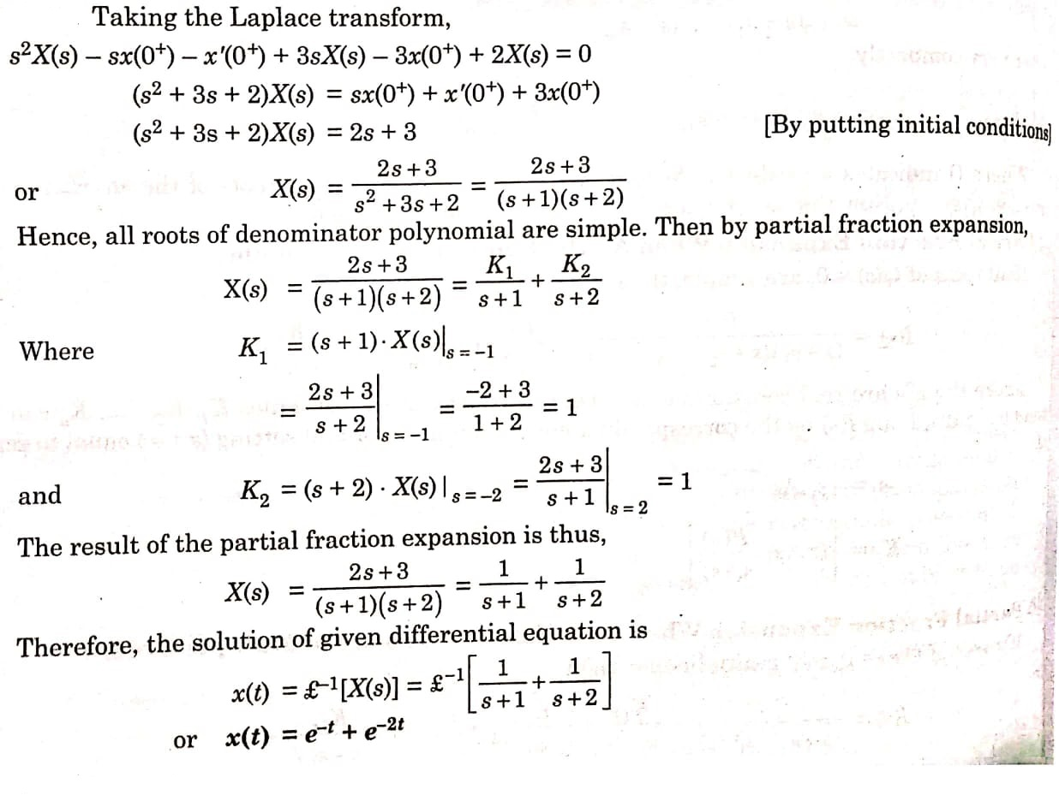
Ex 1) Solve the differential equation
x’’ + 3 x’ + 2x = 0, x(0⁺) = 2, x’(0⁺) = -3
Sol:

Slide 5
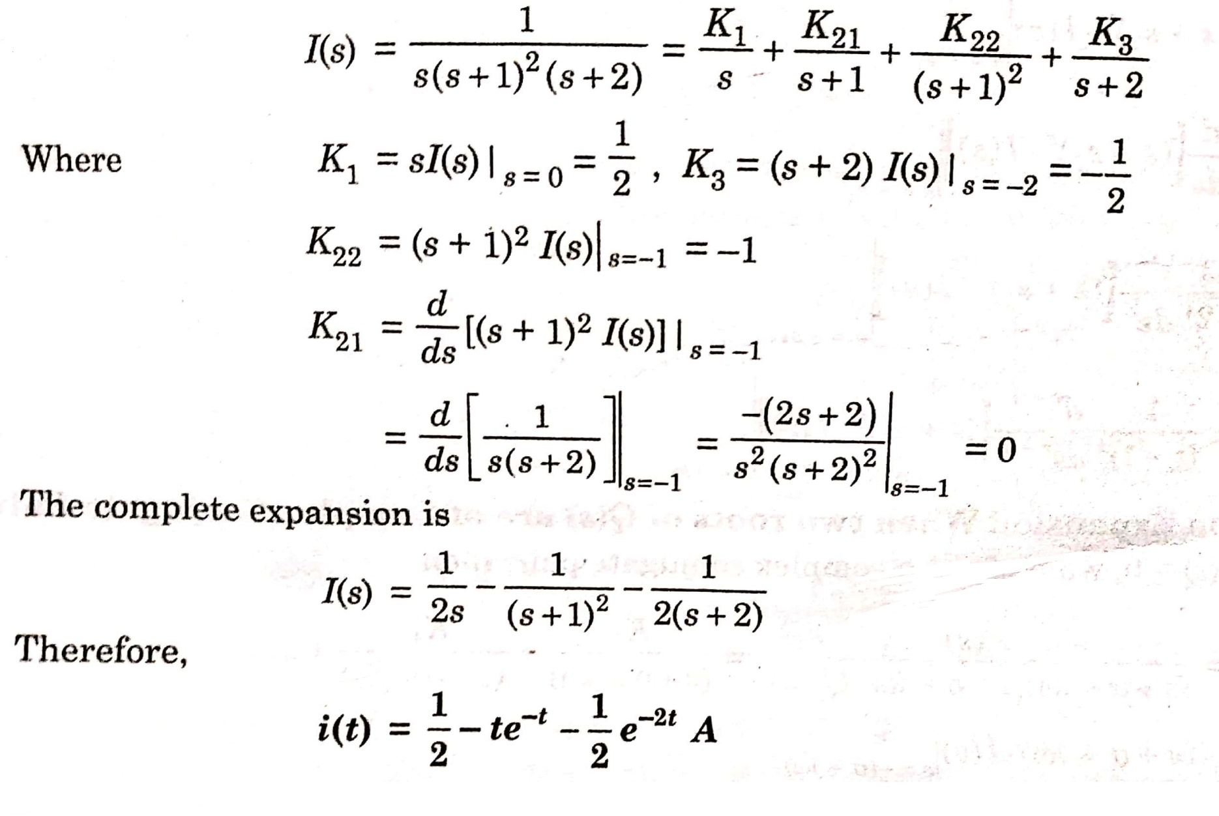
Ex 2) Find i(t), if I(s) = 1/ s(s+1)²(s+2)
Sol:

Slide 6
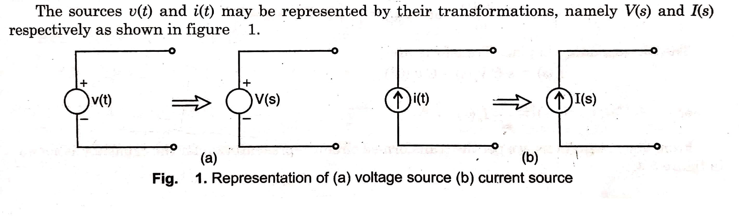
TRANSFORMED CIRCUIT COMPONENT REPRESENTATION
1) Independent sources:

Slide 7
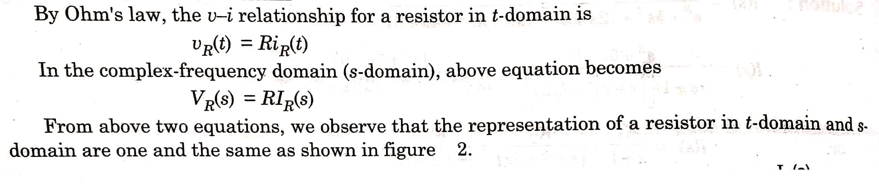
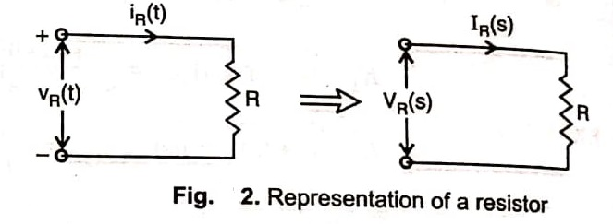
2) Resistance Parameter:

Slide 8
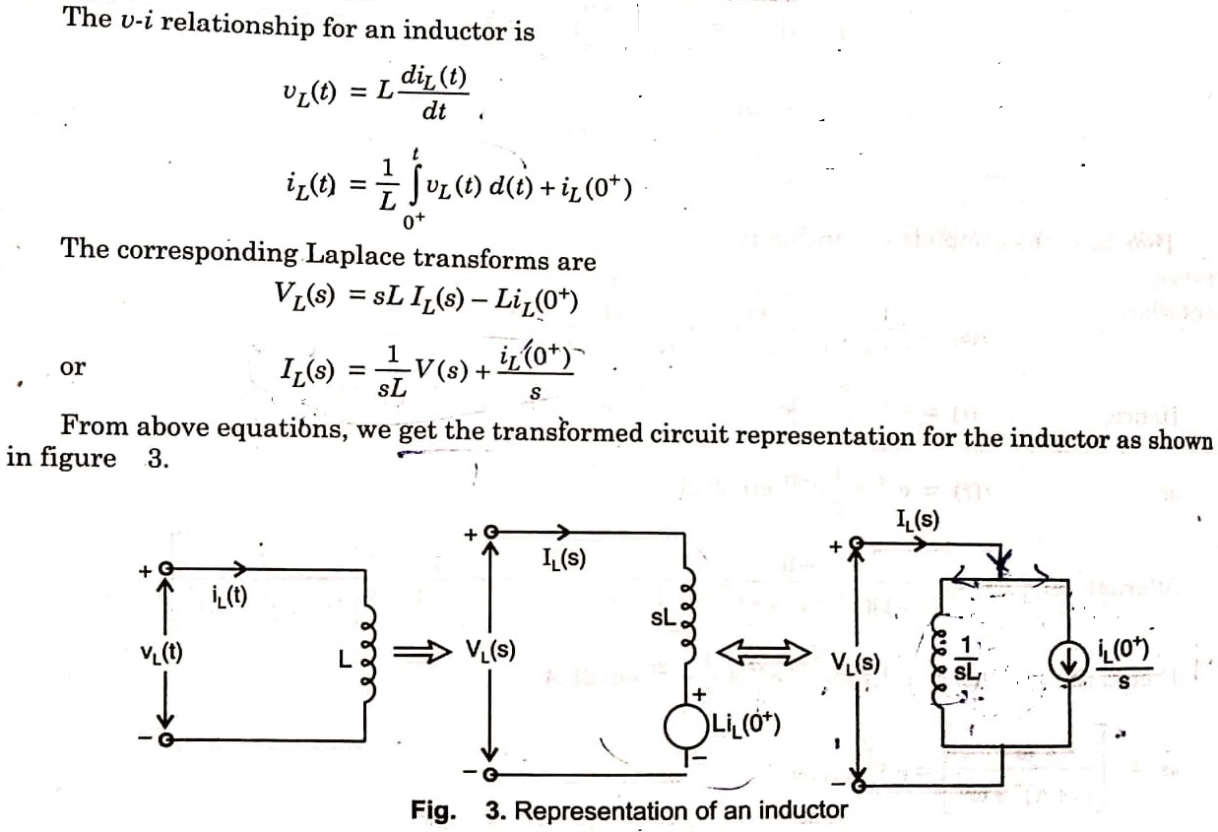
3) Inductance Parameter:

Slide 9
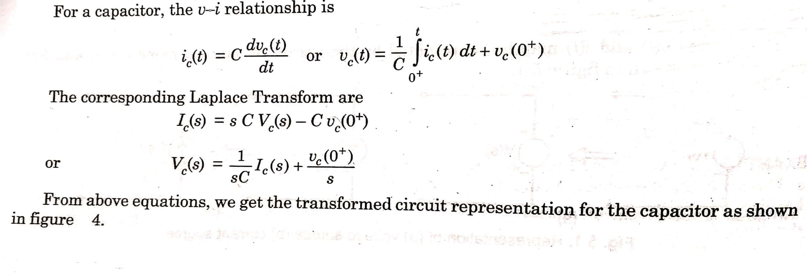
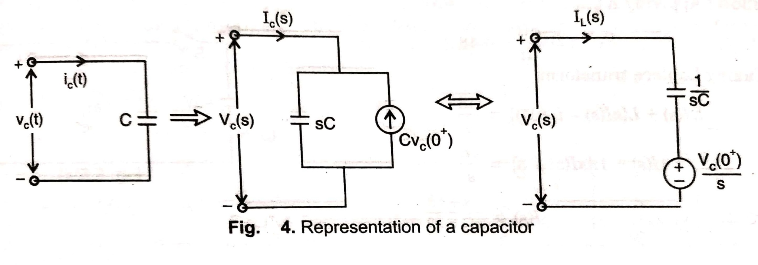
4) Capacitance Parameter:

Slide 10
NUMERICALS

Slide 11
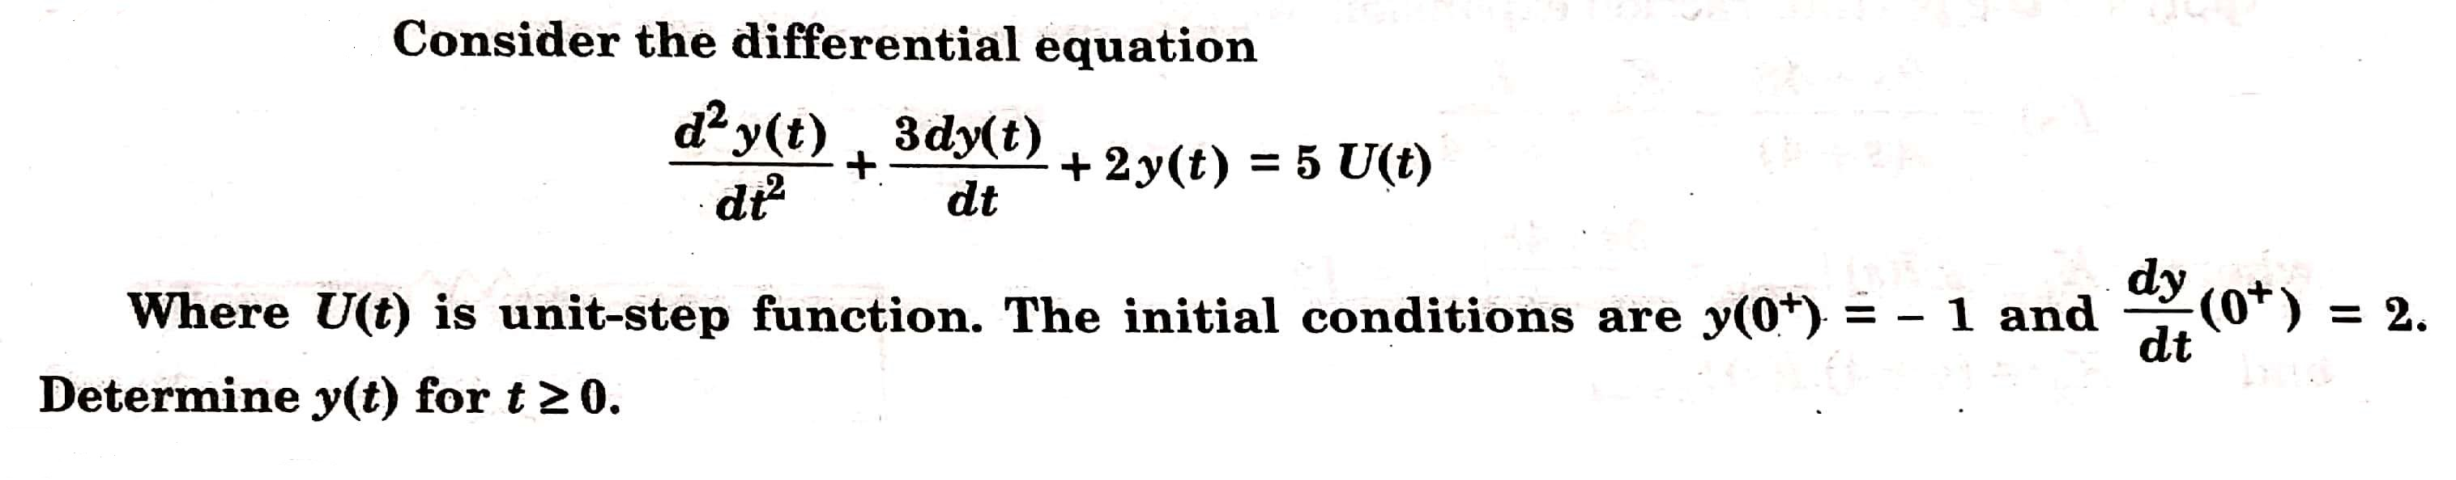
Q 1)

Slide 12
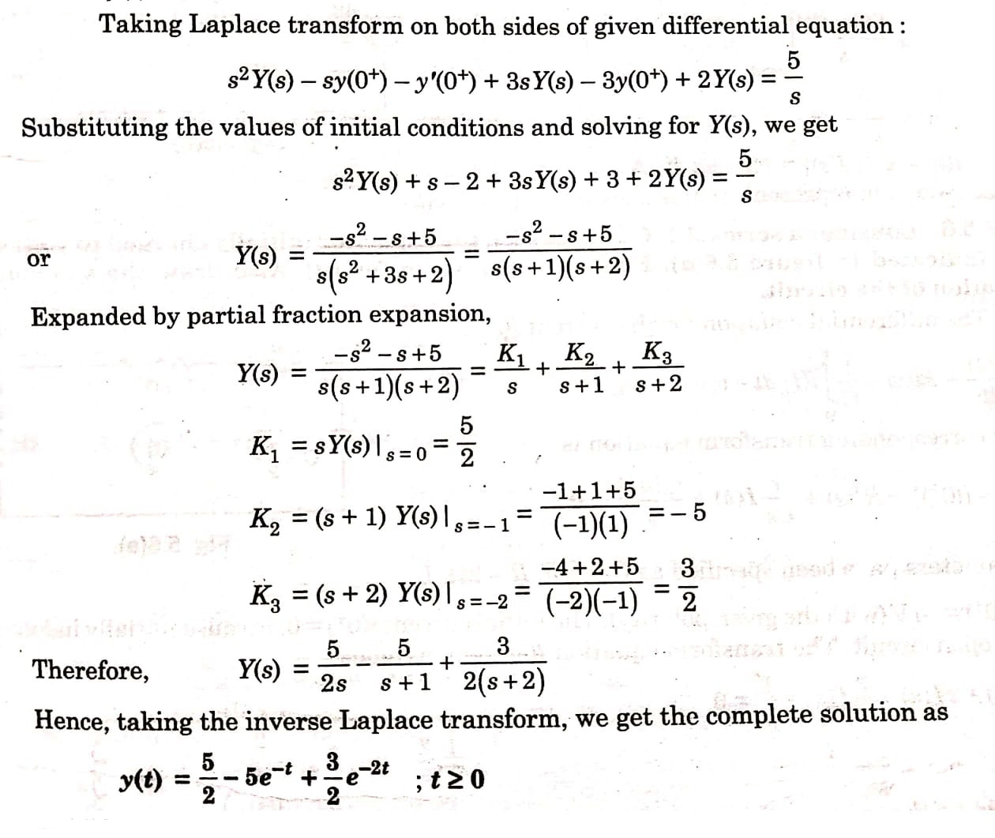
SOLUTION 1

Slide 13
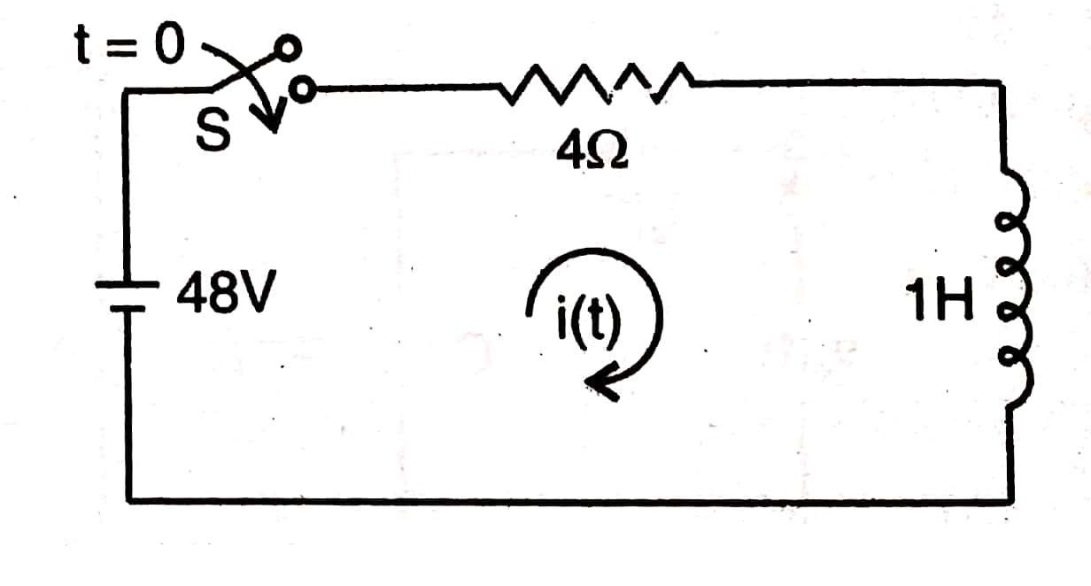
Q 2) Consider the R-L circuit with R= 4 Ω and L= 1 H excited by a 48 V d.c. source as shown in figure below. Assume the initial current through the inductor is 3 A. Using the Laplace transform determine the current i(t); t ≥ 0. Also draw the s-domain representation of the circuit.

Slide 14
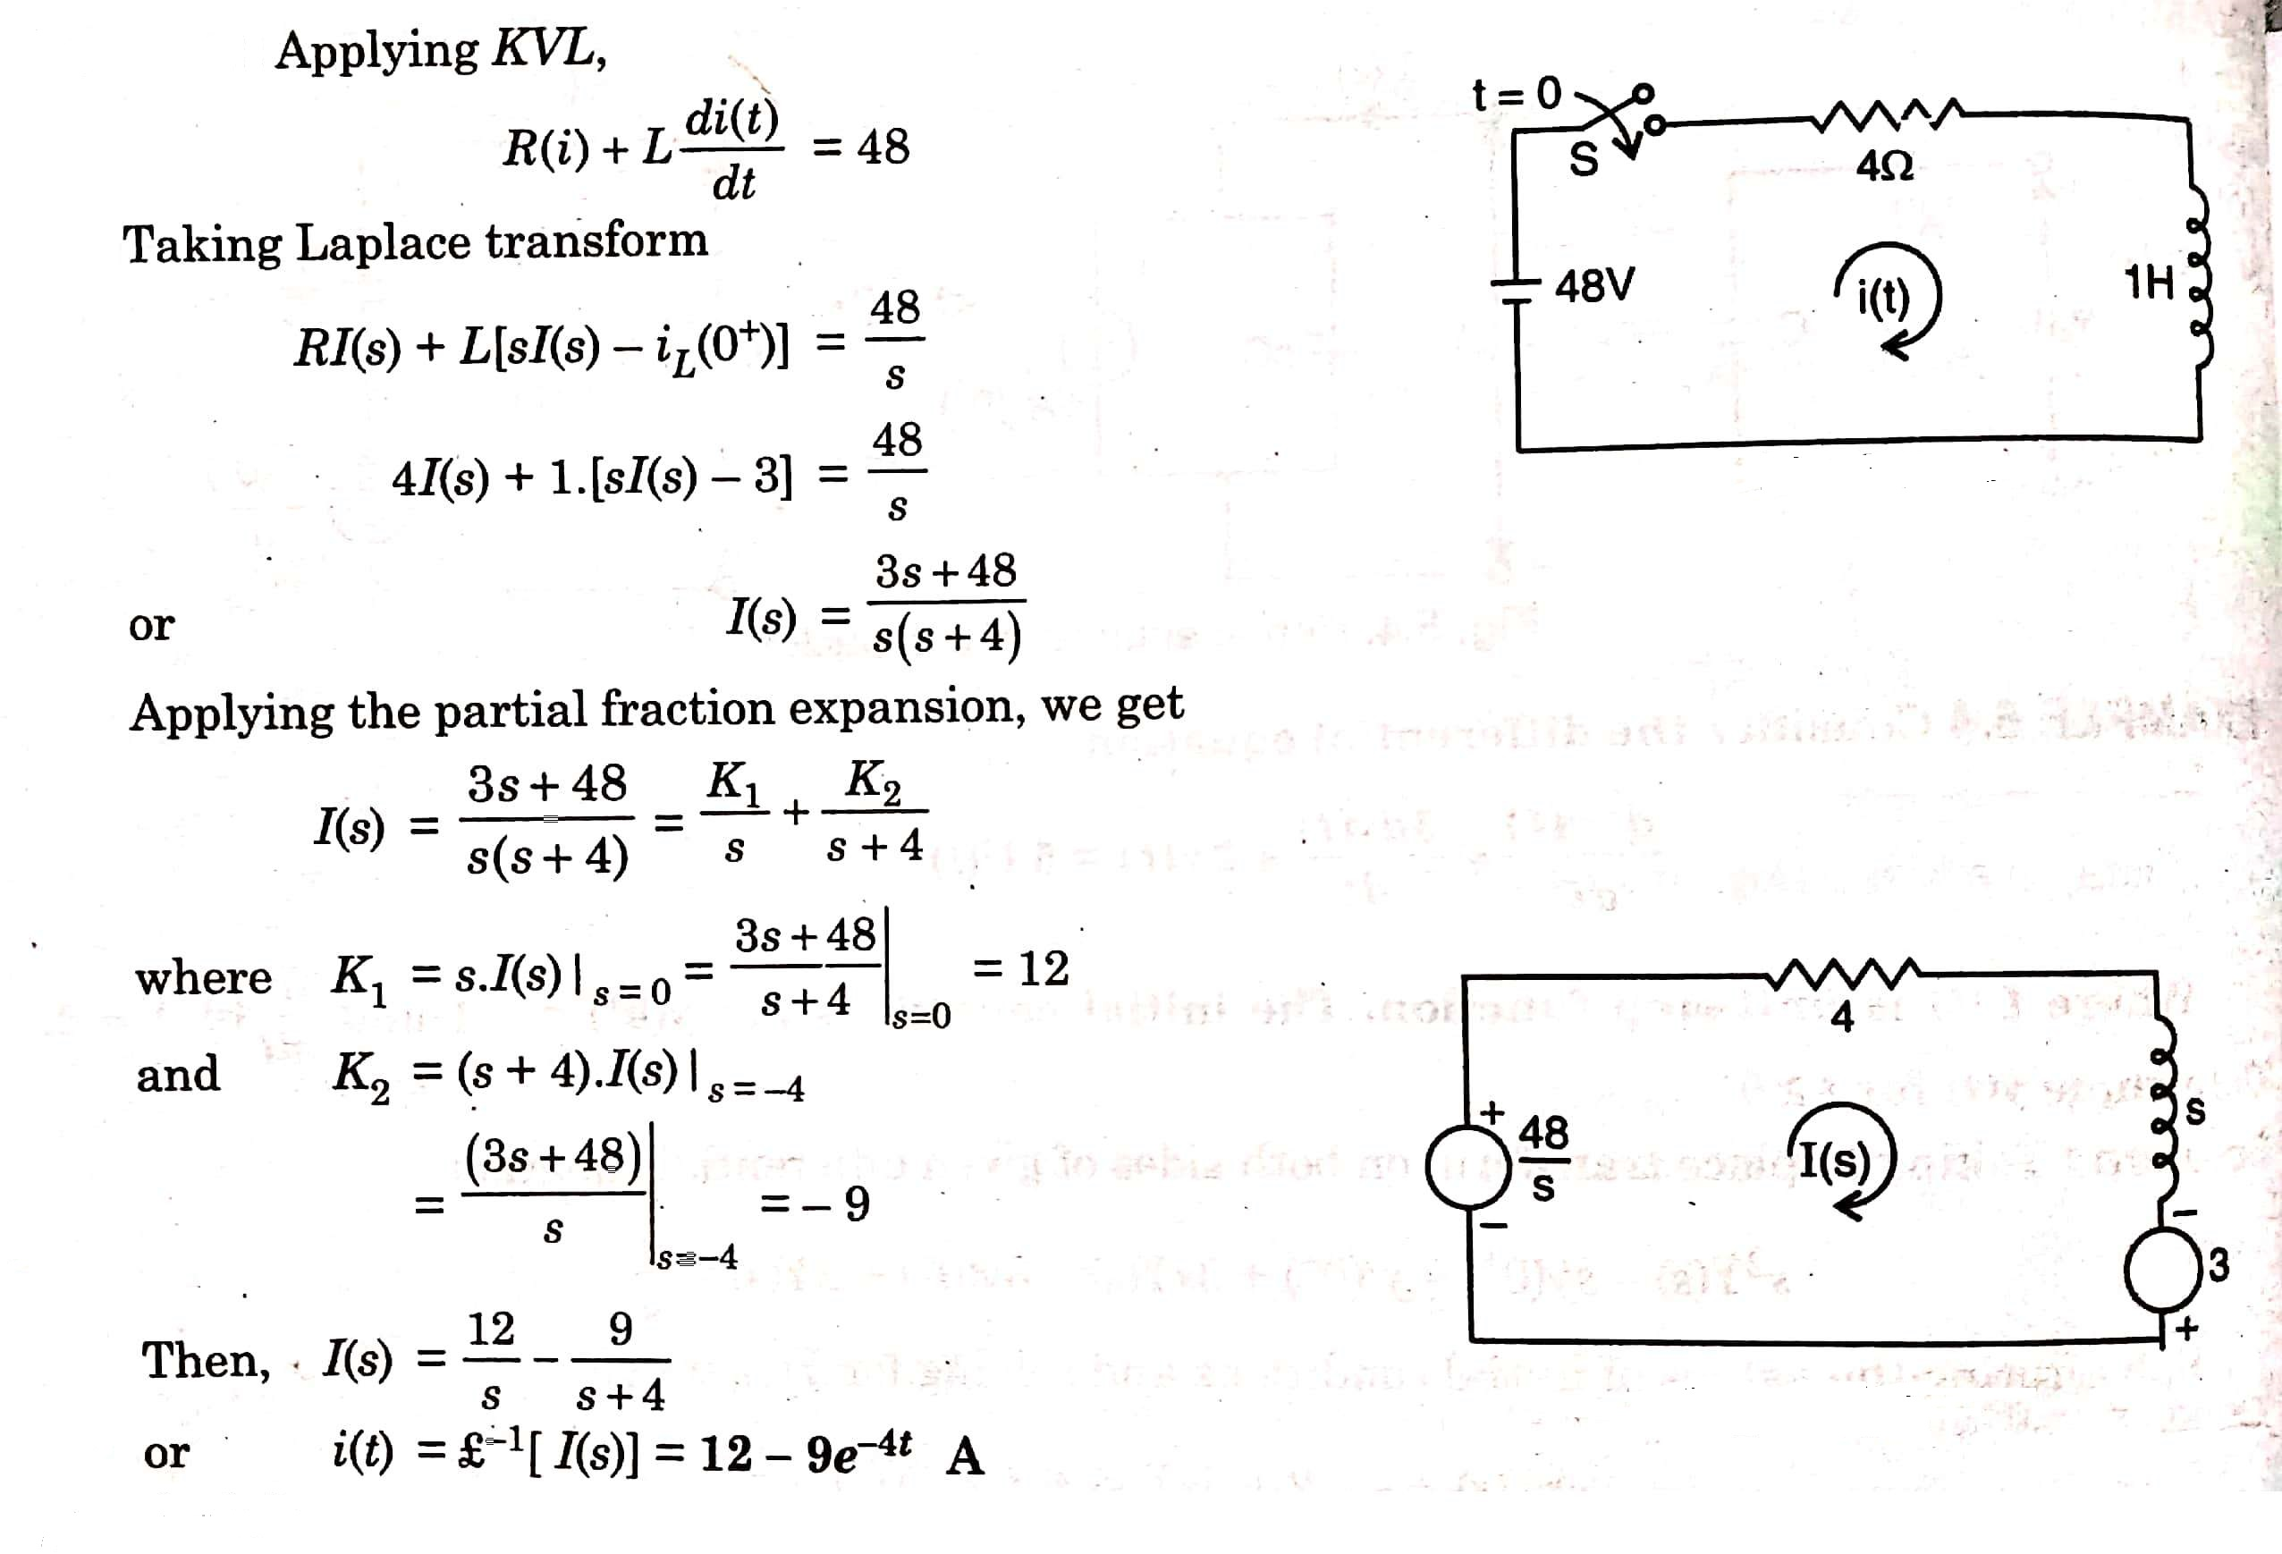
SOLUTION 2

Slide 15
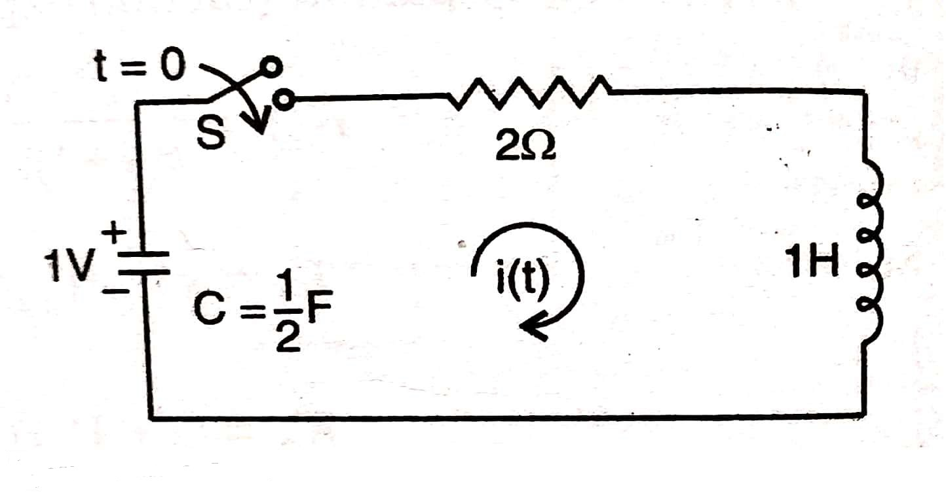
Q 3) Consider a series R-L-C circuit with the capacitor initially charged to 1 V as shown in figure below. Find the expression for i(t) . Also draw the s-domain representation of the circuit.

Slide 16
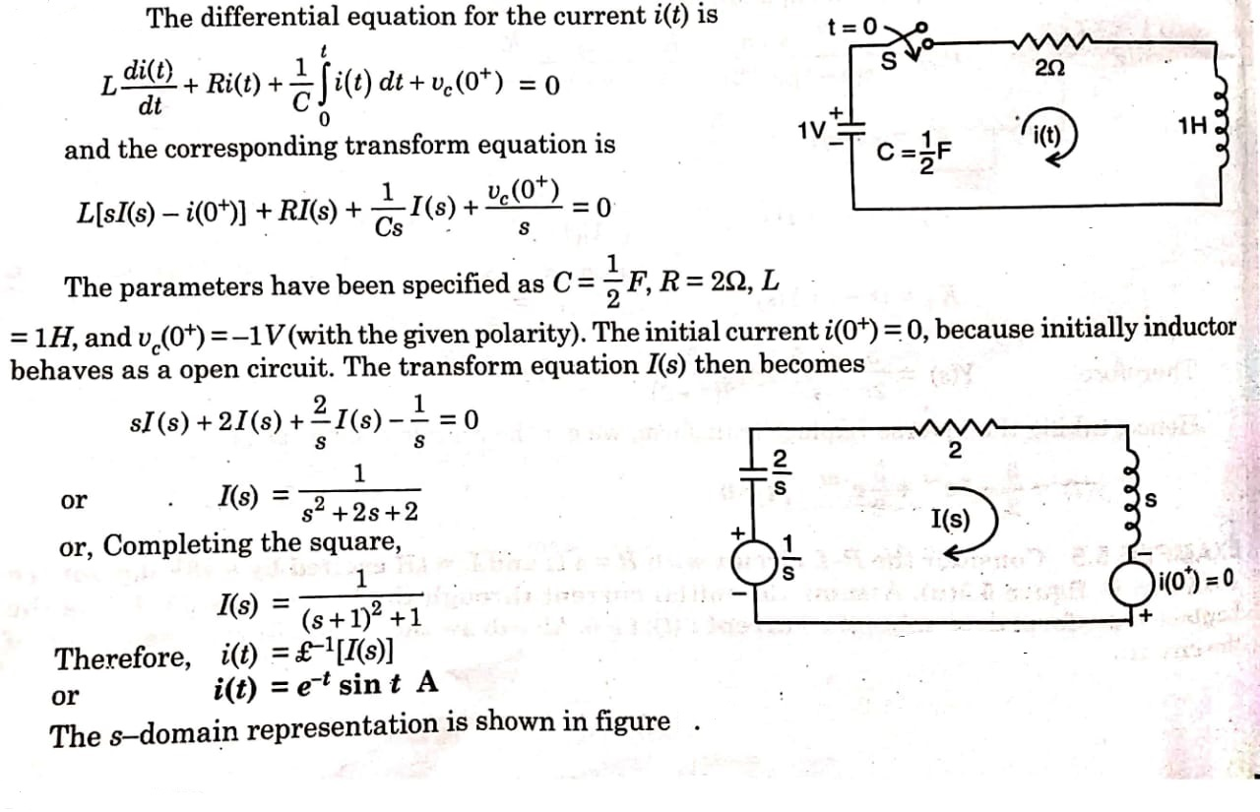
SOLUTION 3

Slide 17
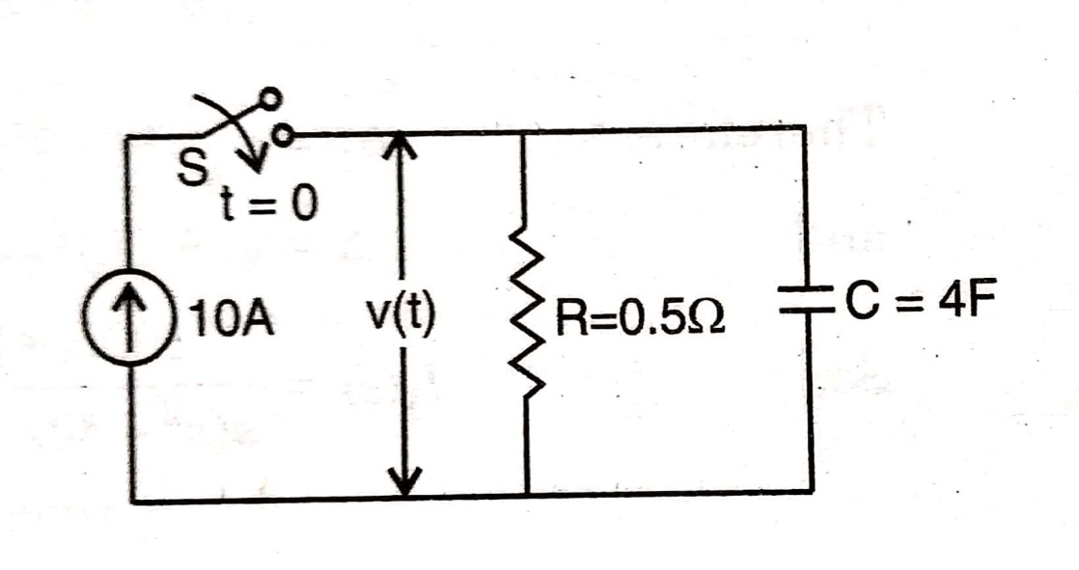
Q 4) Consider the R-C parallel circuit as shown in figure below with R = 0.5 Ω and C= 4F excited by d.c. current source of 10 A. Determine the voltage across the capacitor by applying Laplace transformation. Assume the initial voltage across the capacitor as 2V. Also draw the s-domain representation of the circuit.

Slide 18
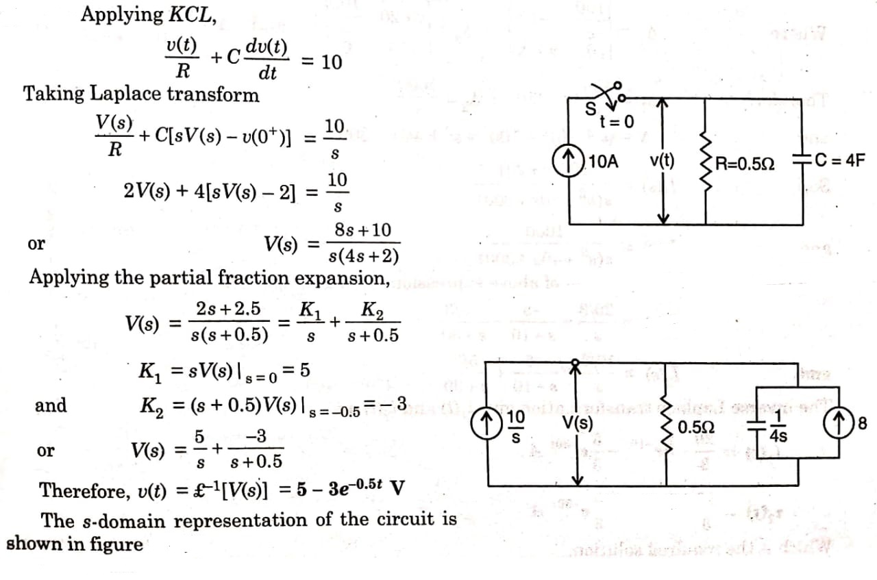
SOLUTION 4

Slide 19
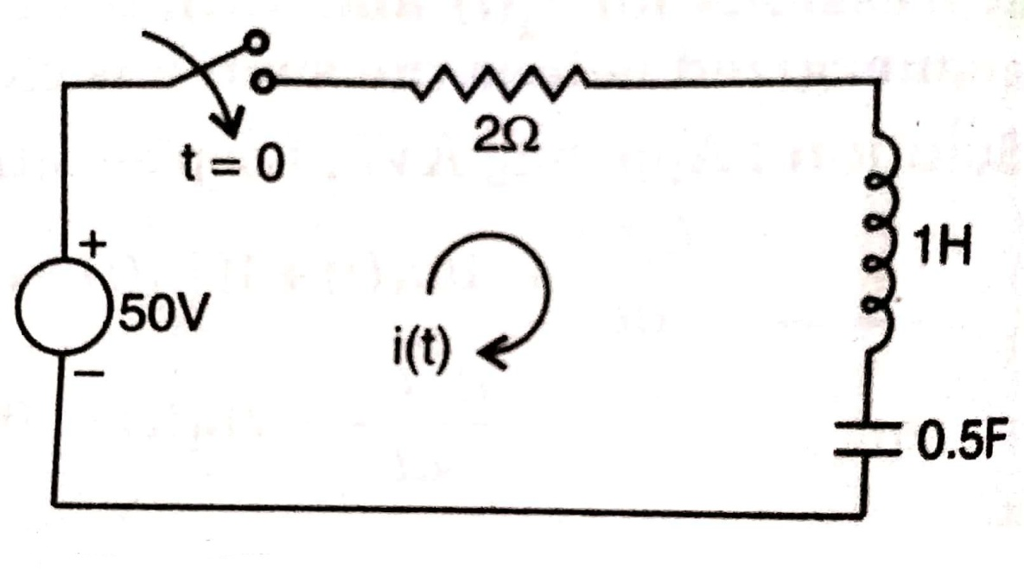
Q 5) In the series R-L-C circuit shown in figure below, there is no initial charge on the capacitor. If the switch ‘S’ is closed at t = 0, determine the resulting current.

Slide 20
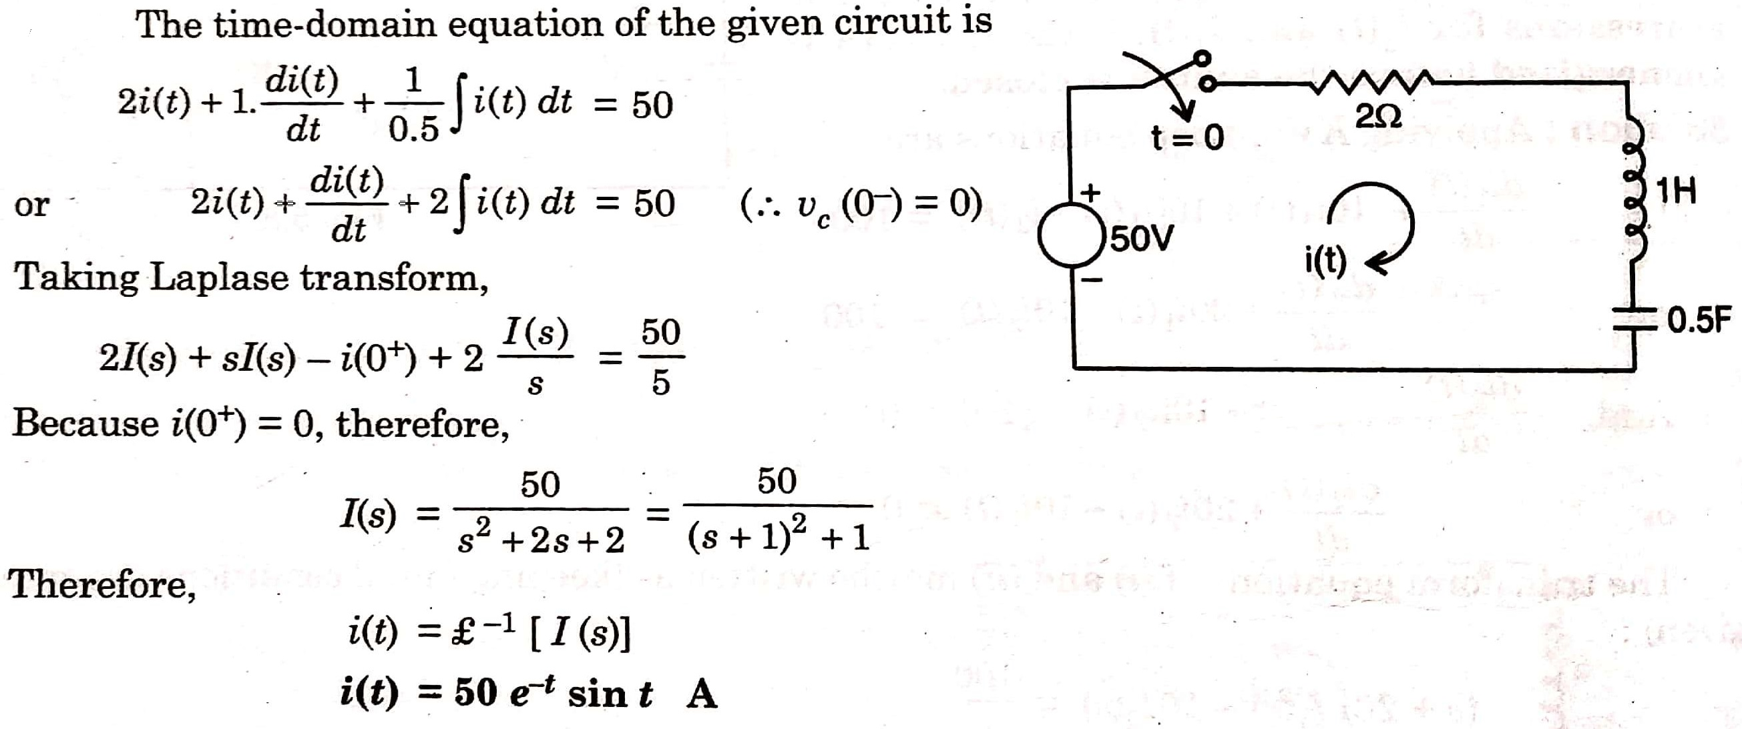
SOLUTION 5

Slide 21
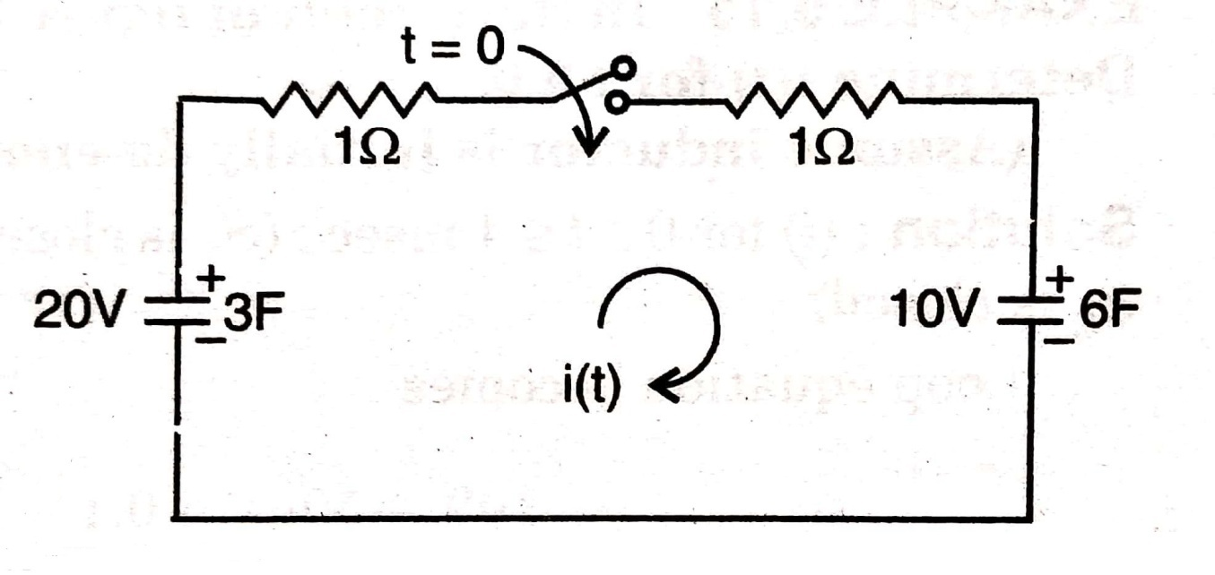
Q 6) Solve for i(t) in the circuit shown in figure below in which 3F capacitor is initially charged to 20V, the 6F capacitor to 10 V, and the switch is closed at t = 0. Also draw the transformed circuit(s-domain representation).

Slide 22
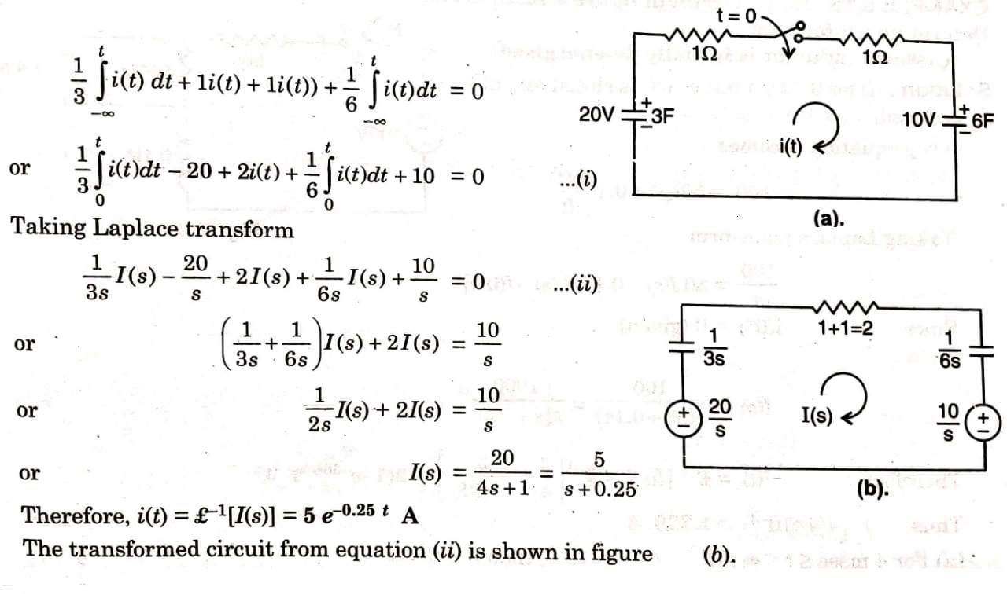
SOLUTON 6

Slide 23
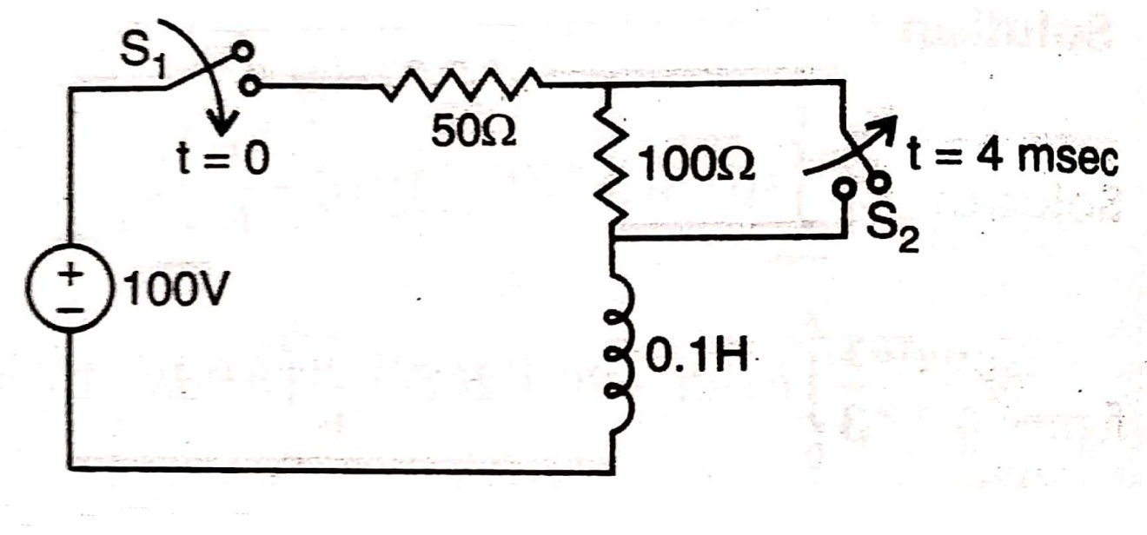
Q 7) In the circuit shown in figure below, switch ‘S₁’ is closed at t = 0, and ‘S₂’ is opened at t = 4 msec. Determine i(t) for t > 0 .
(Assume inductor is initially de-energized)

Slide 24
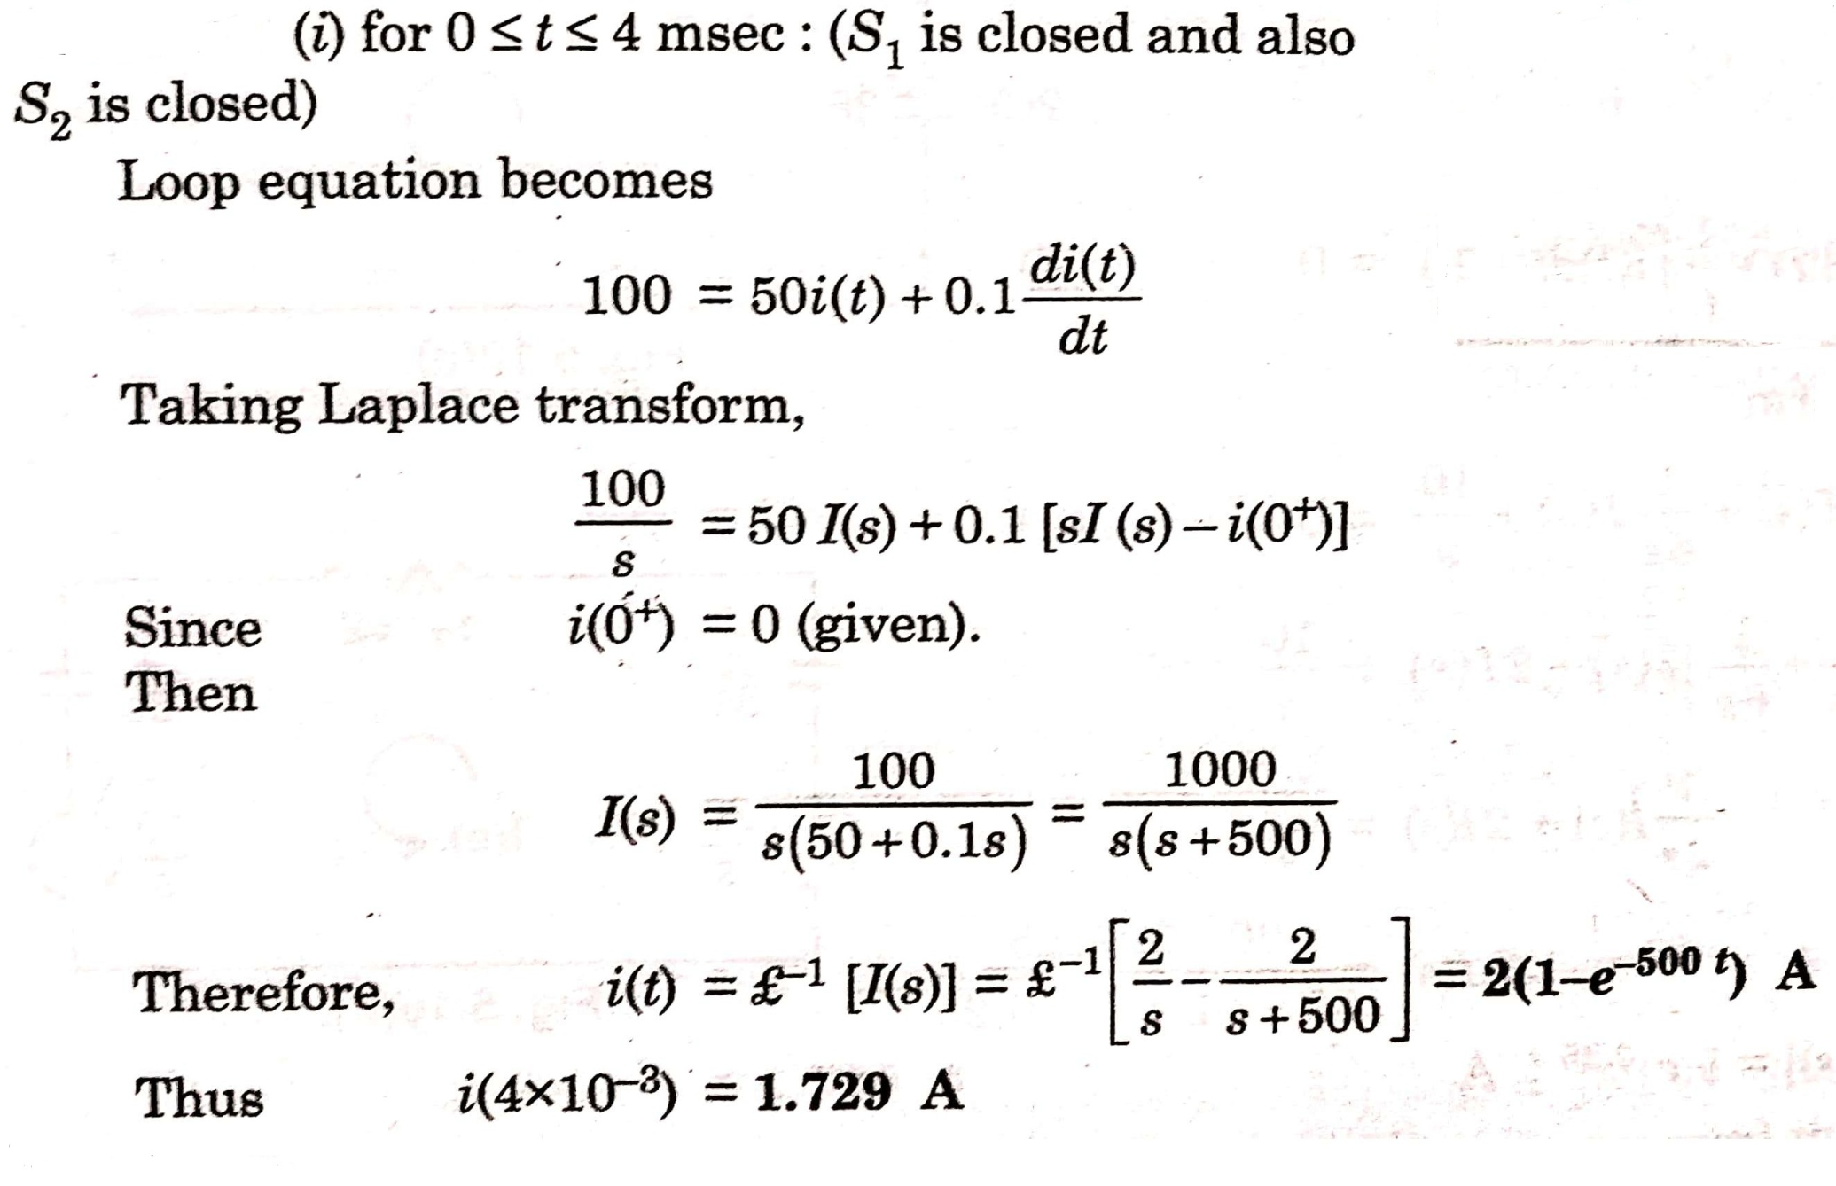
SOLUTION 7

Slide 25
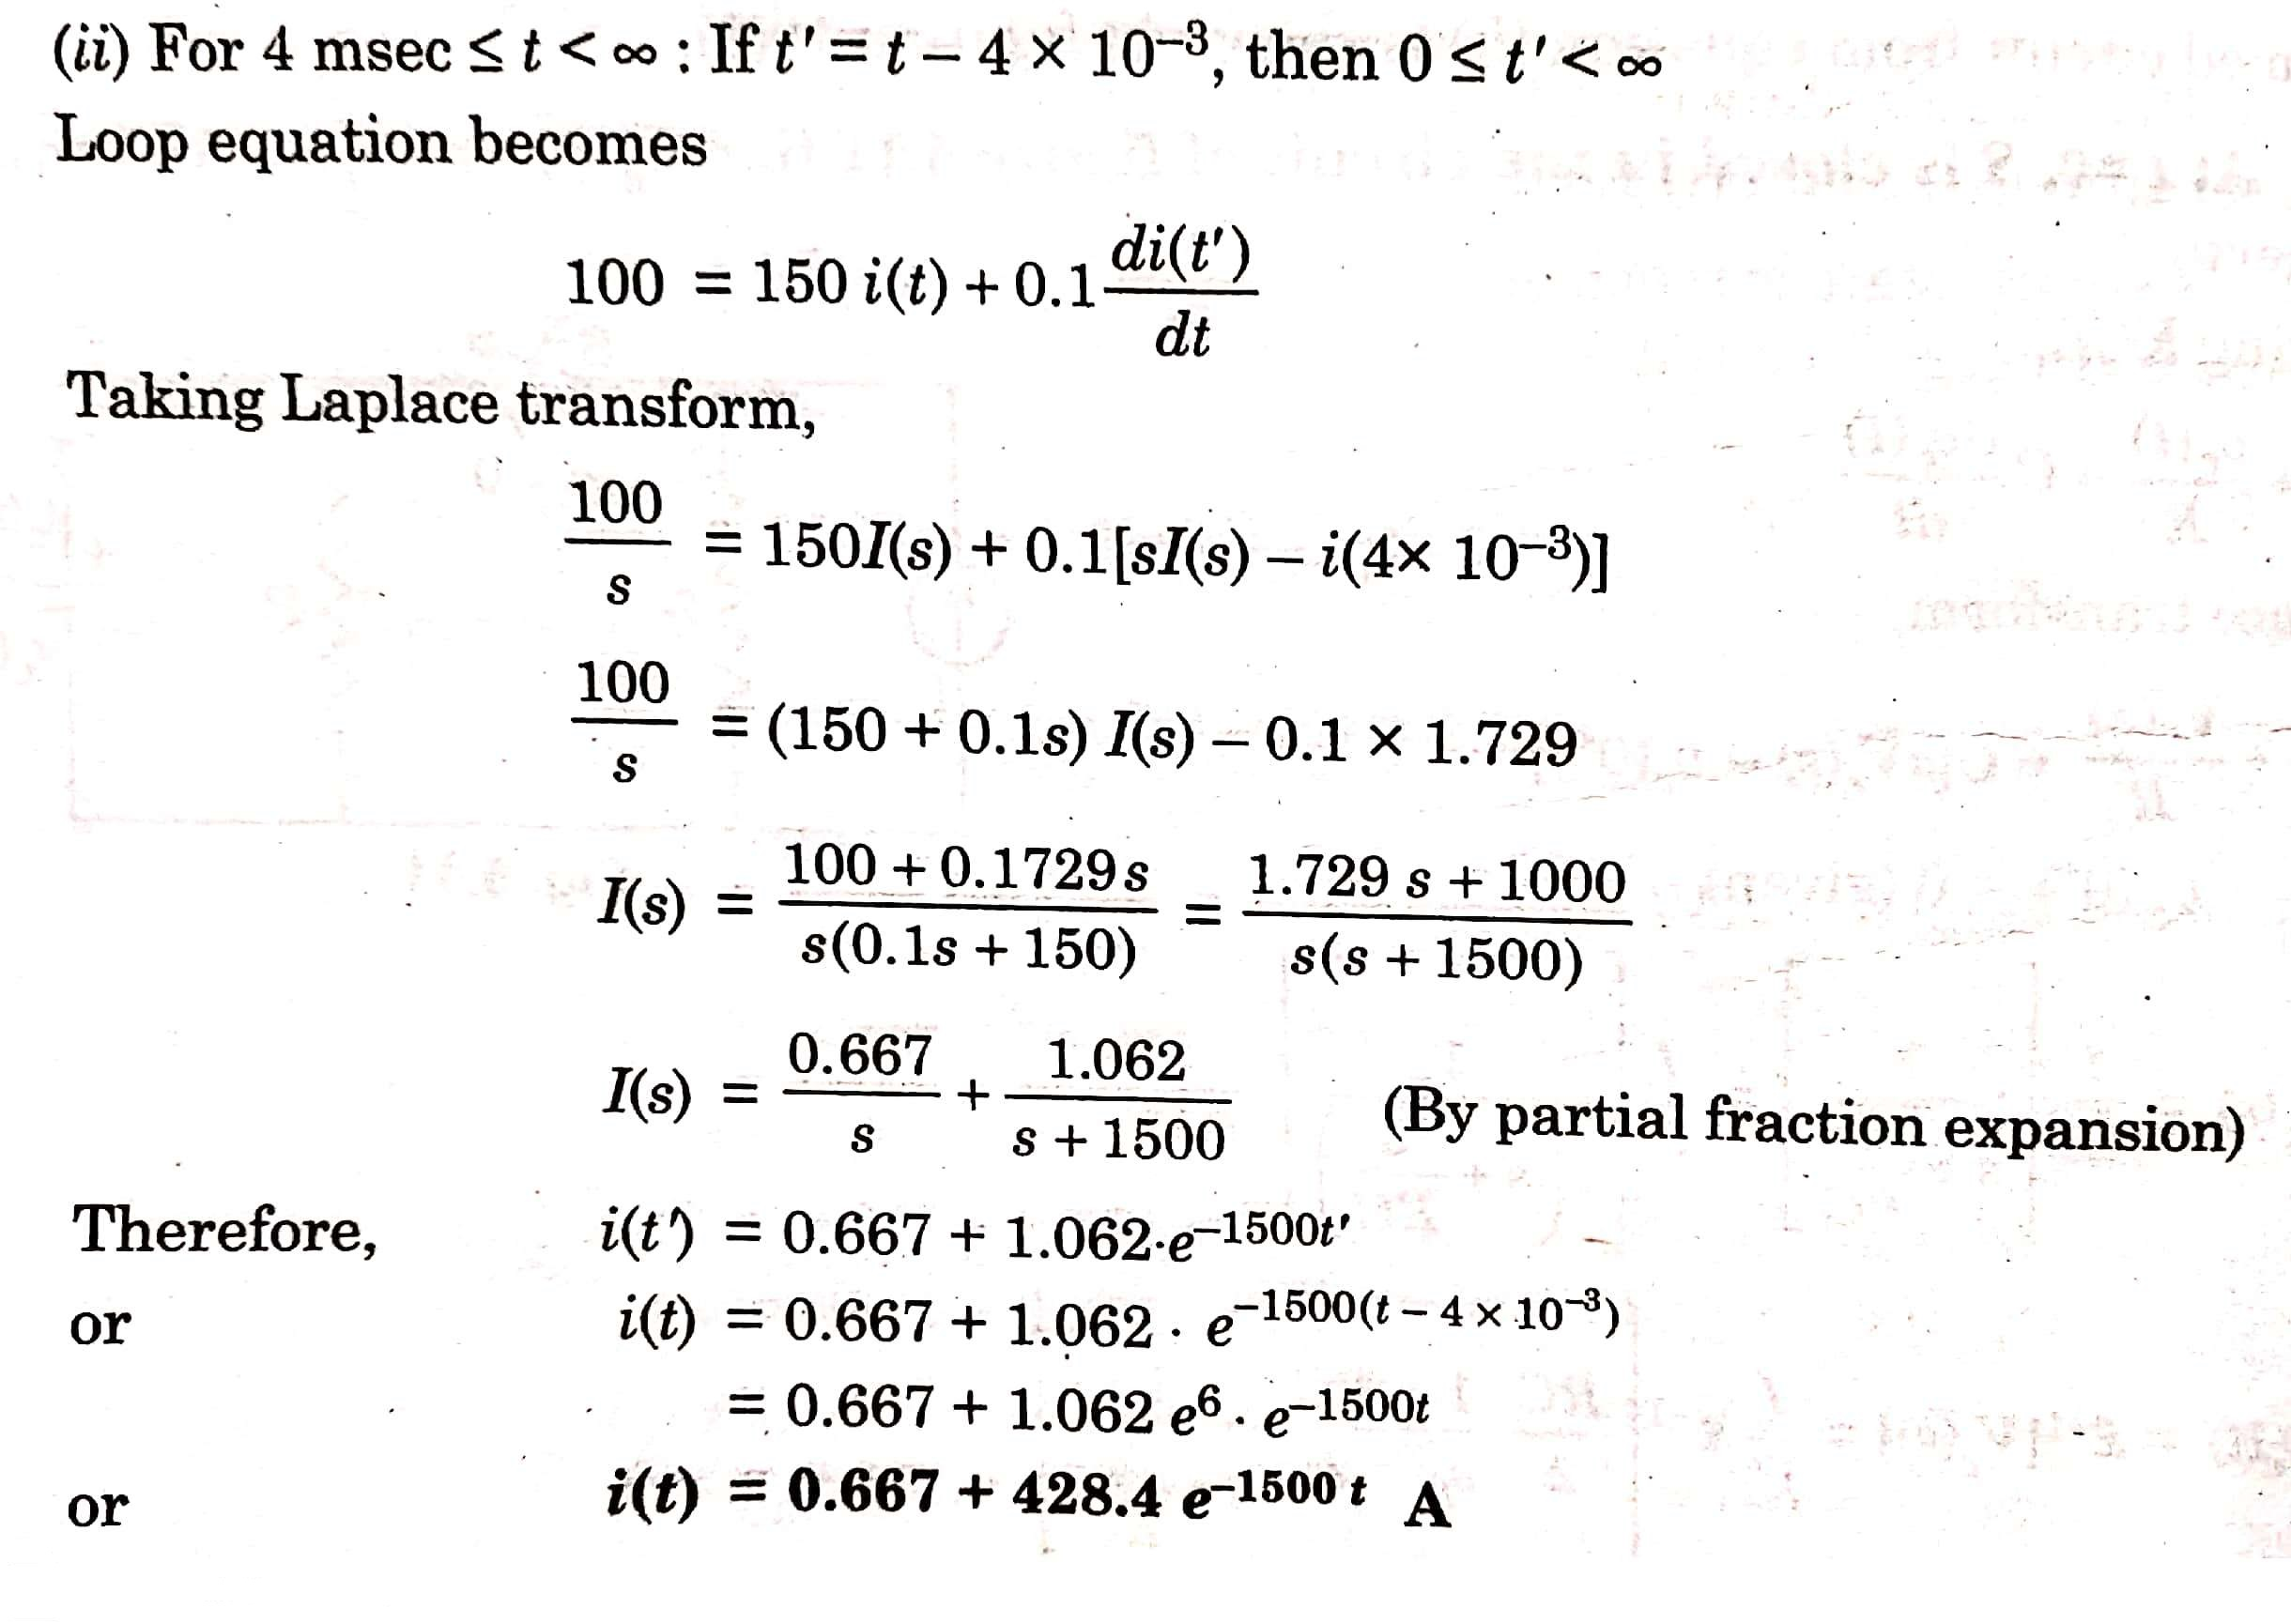

Slide 26
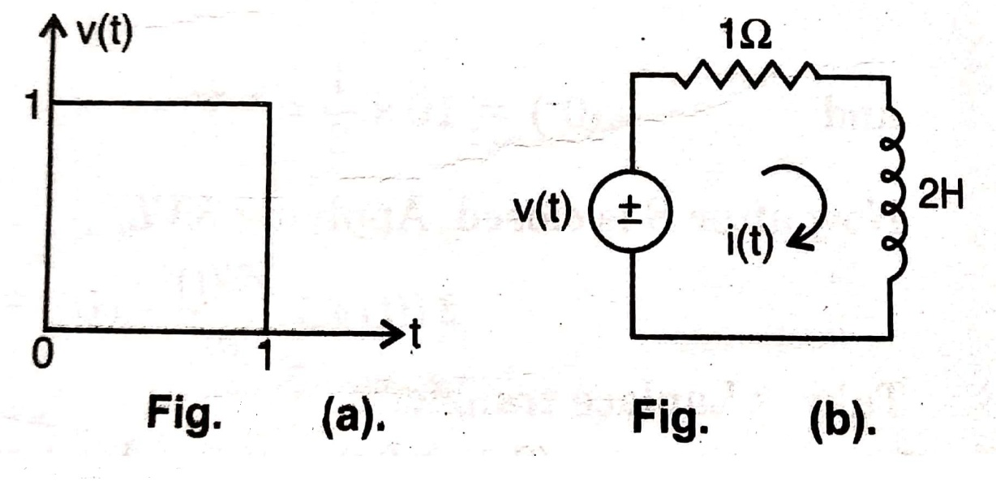
Q 8) (a) Obtain the Laplace transform of the pulse shown in figure (a) below.
(b) In figure (b) if v(t) is the pulse (a), determine i(t).

Slide 27
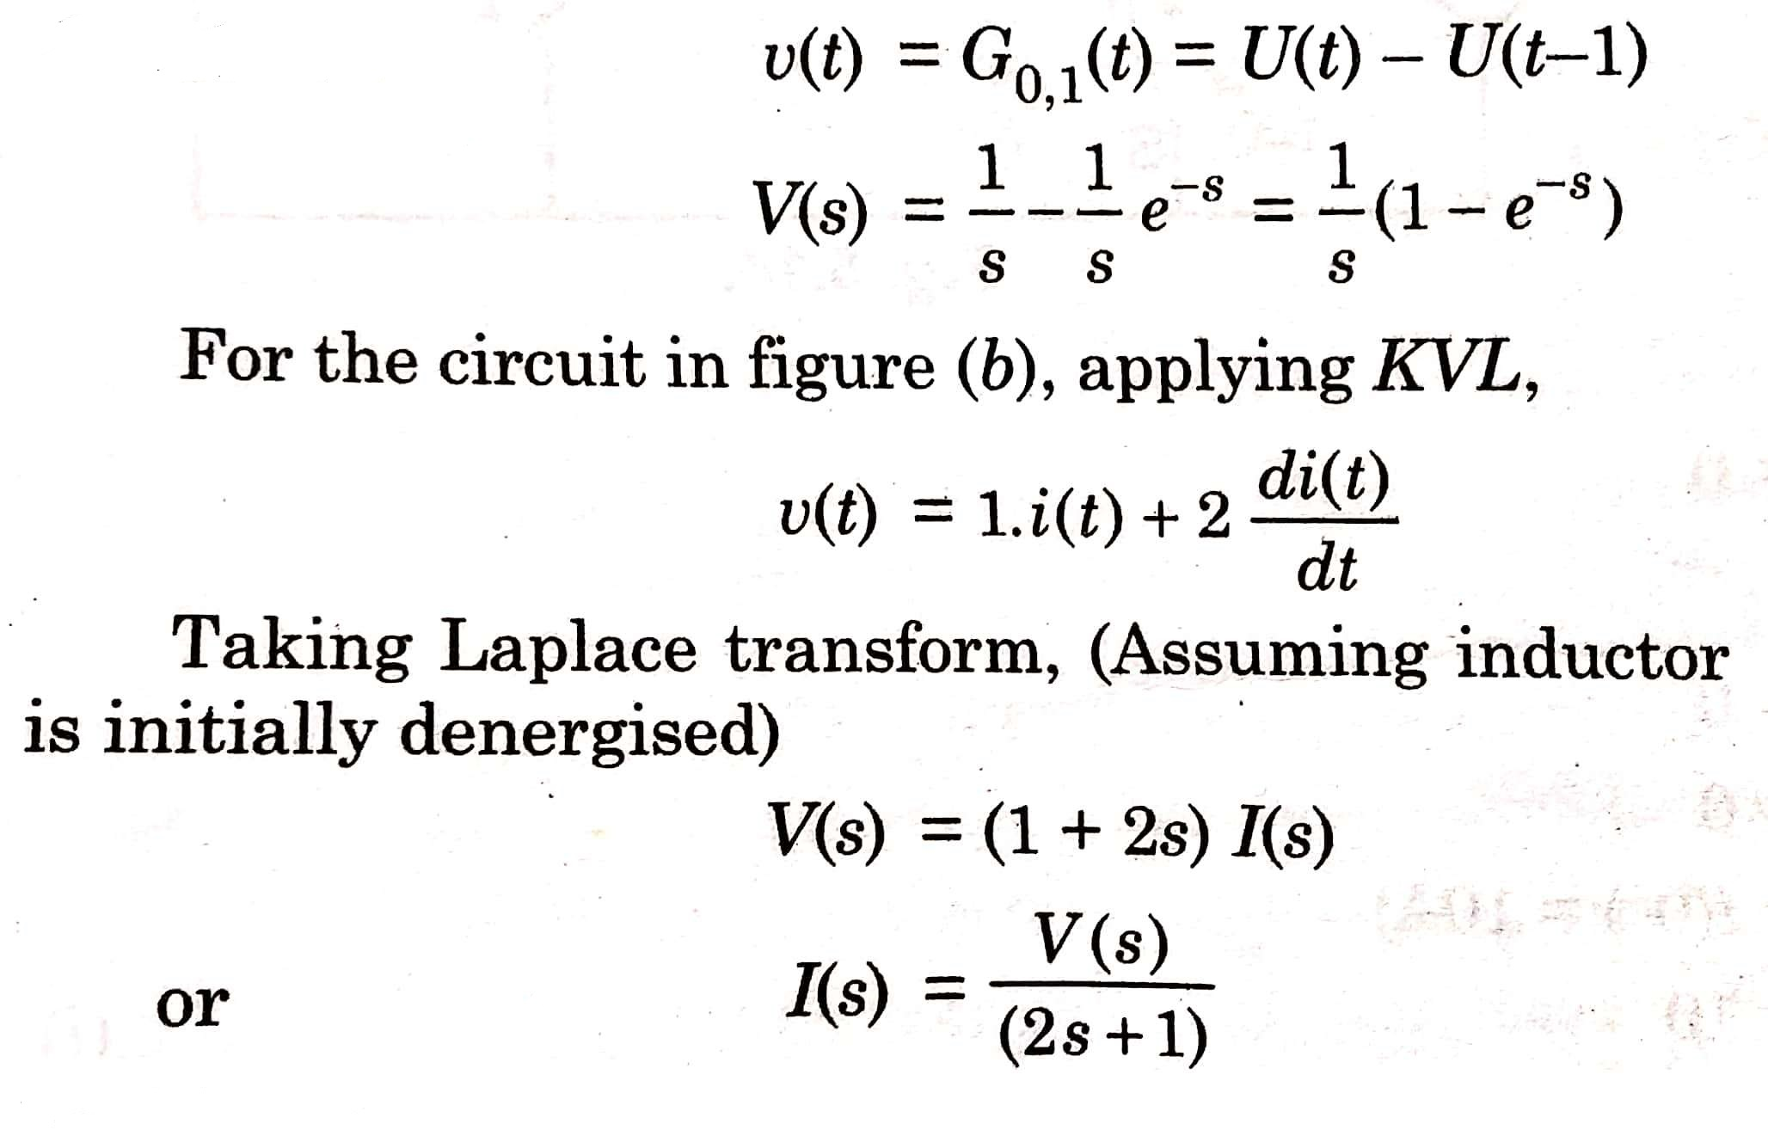
SOLUTION 8

Slide 28
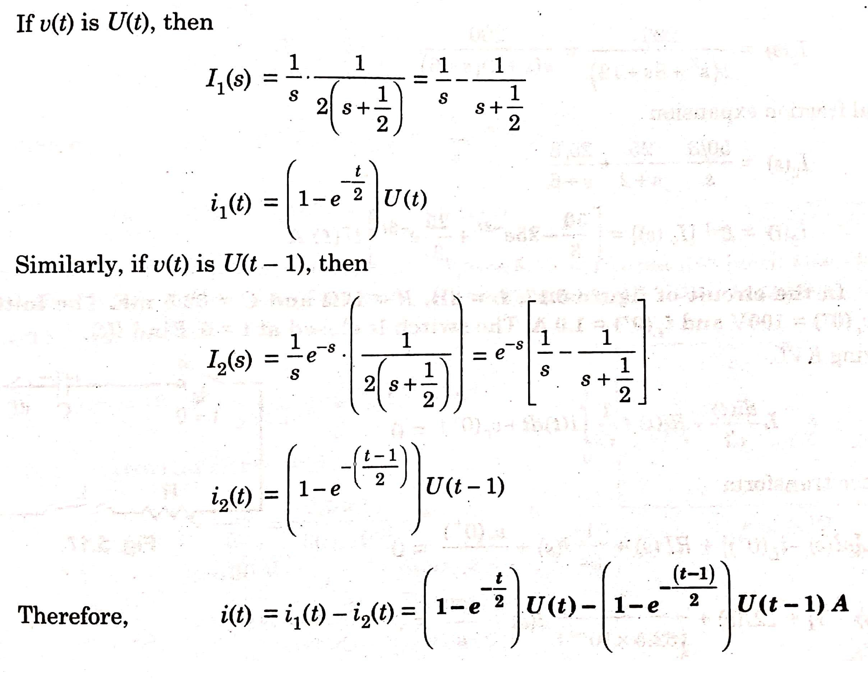

Slide 29
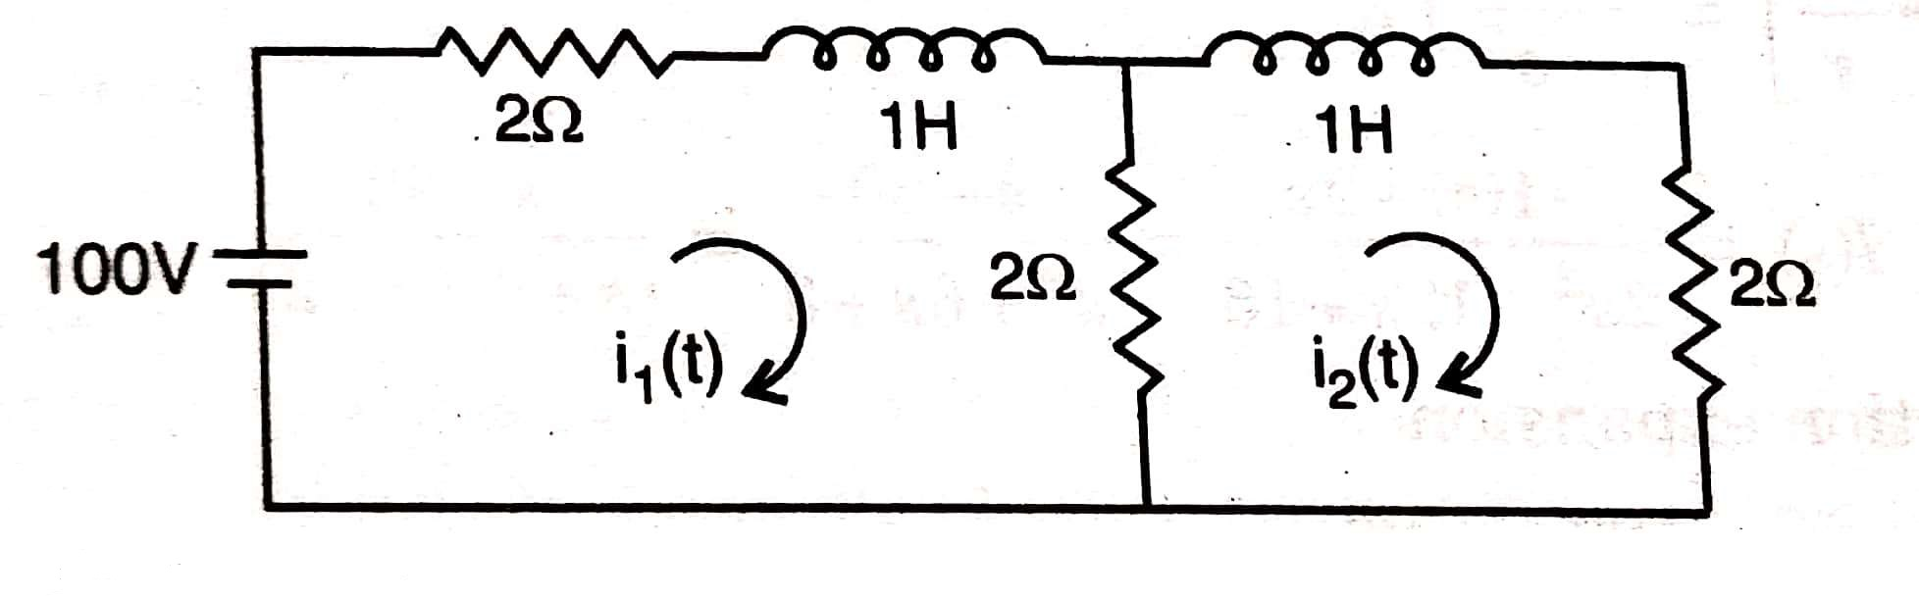
Q 9) In the network shown in figure below, find current i₂(t) in the circuit.

Slide 30
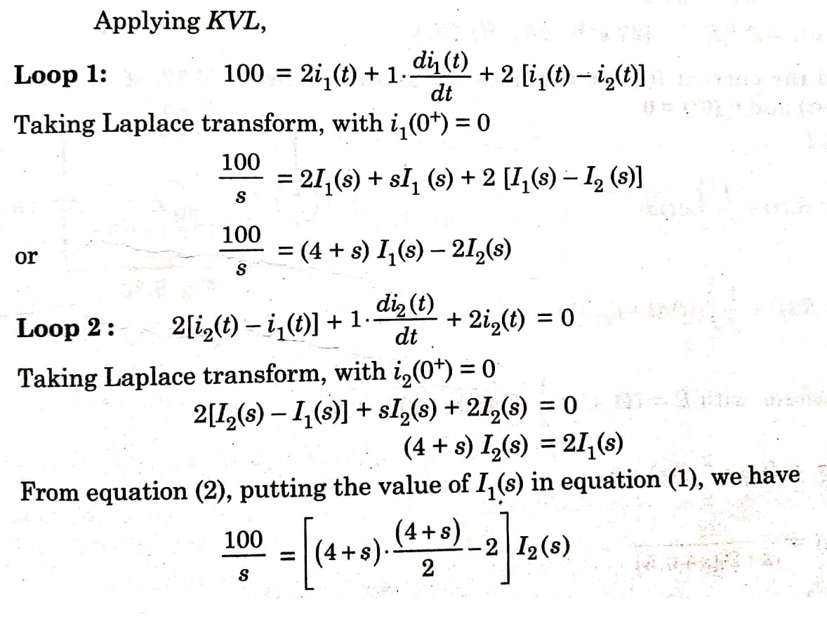
SOLUTION 9

Slide 31
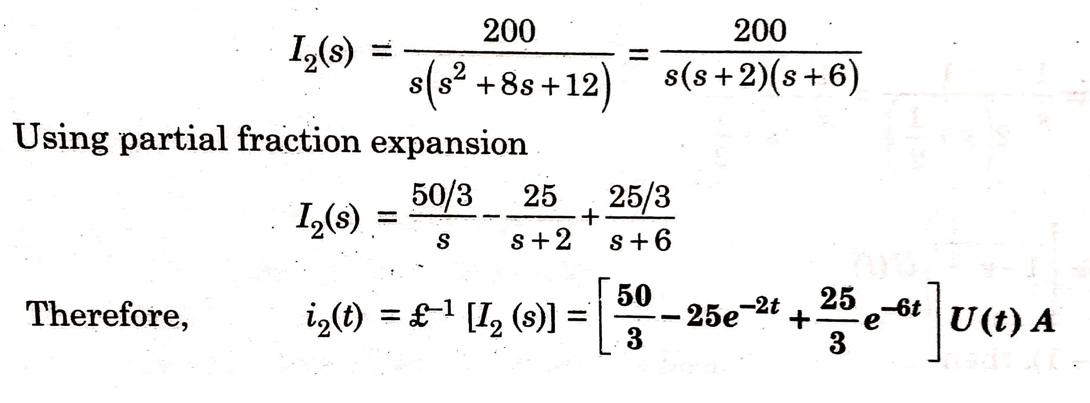

Slide 32
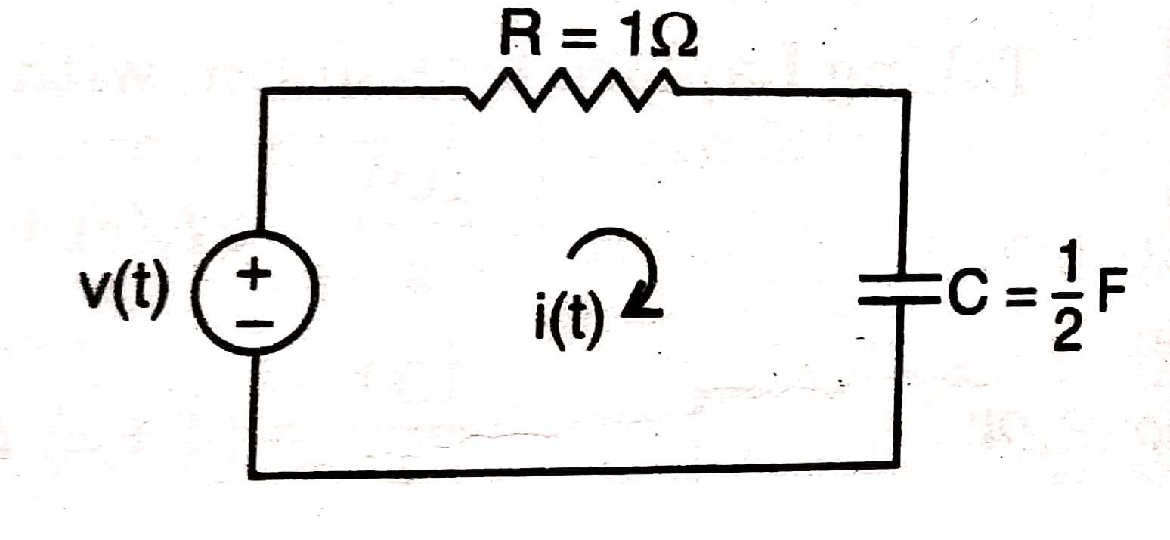
Q 10) Find the current i(t) for the network shown in figure below, if the voltage source V(t) = 2 e^{-0.5t} U(t) and
v_{c}(0⁺) = 0.

Slide 33
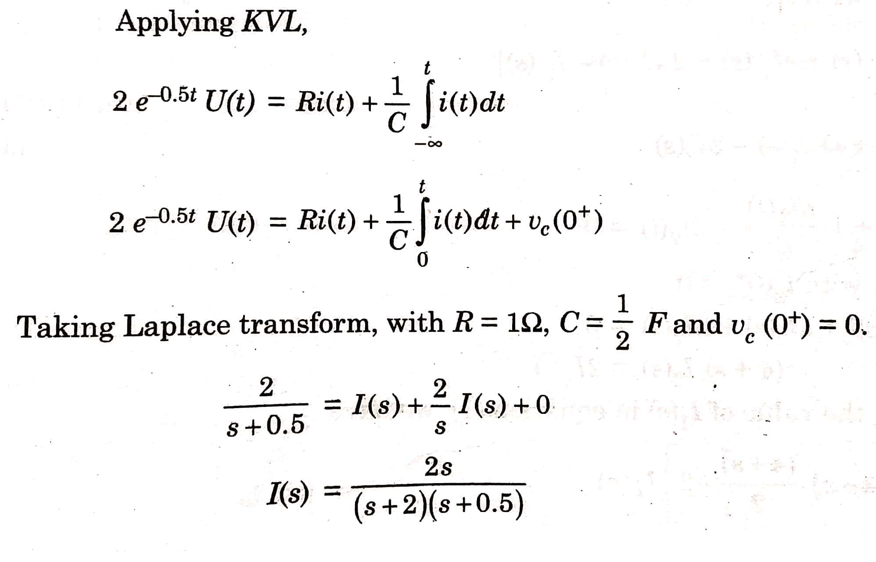
SOLUTION 10

Slide 34
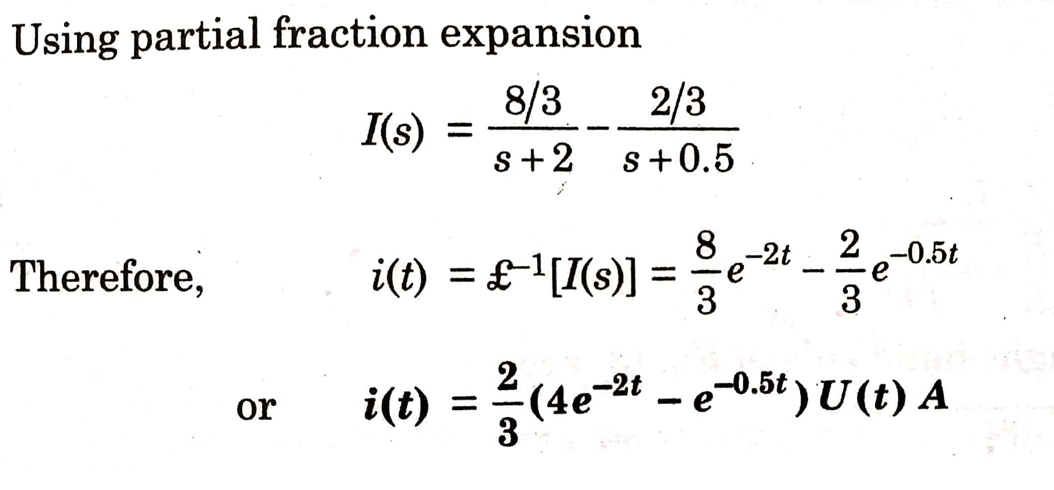

Slide 35
QUESTIONS FOR PRACTICE

Slide 36
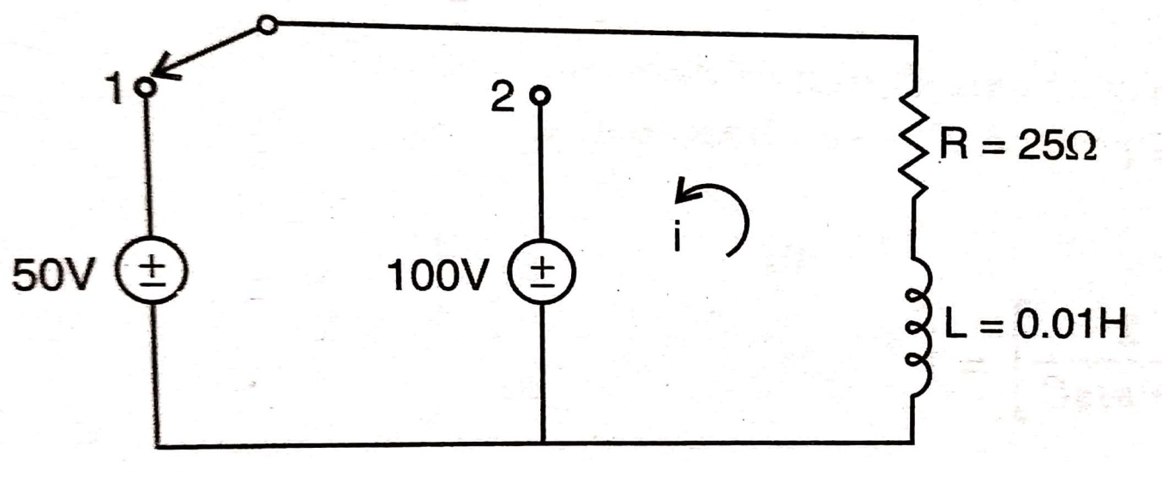
Q 1) In the R-L circuit shown in figure below, the switch is in position ‘1’ long enough to establish steady-state conditions, and at t = 0 it is switched to position ‘2’. Find the resulting current.

Slide 37
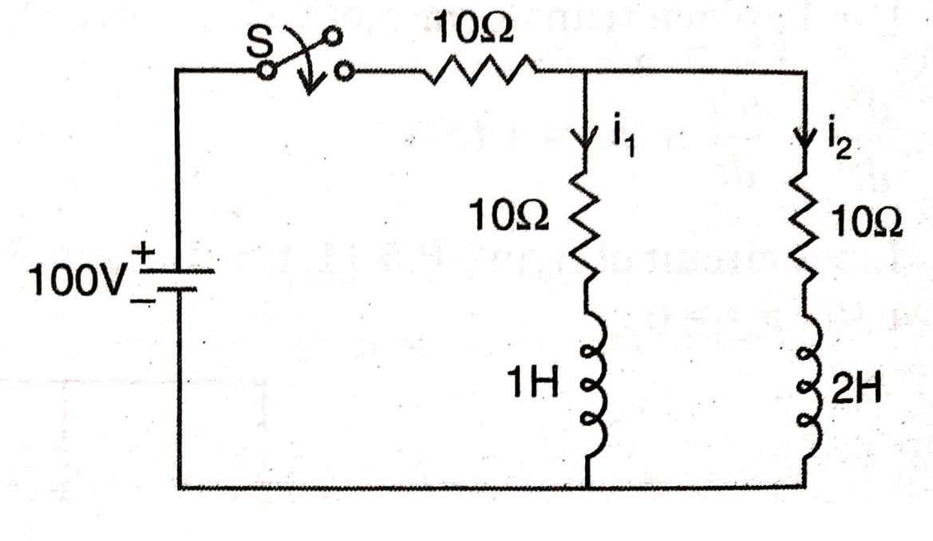
Q 2) In the circuit shown in figure below, the switch ‘S’ is closed at t = 0 with the network previously un-energized. Evaluate i₁(t).

Slide 38
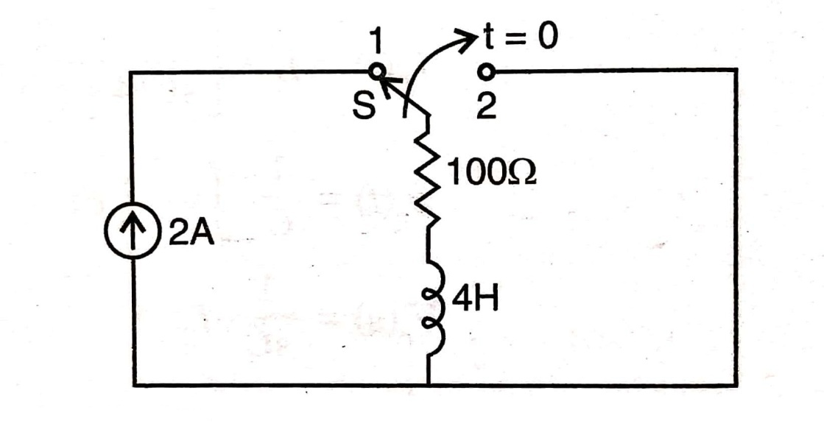
Q 3) In the circuit shown in figure below, switch ‘S’ is moved from 1 to 2 at t = 0 . Determine the voltage across and current through the resistor.

Slide 39
ANSWERS
1) i(t) = 4 – 6 e^{-2500t} A.
2) i₁(t) = 3.33 + 1.121 e^{-6.35t} – 4.5 e^{-23.65t} A.
3) V_{R}(t) = 200 e^{-25t} V.
i_{R}(t) = 2 e^{-25t} A.

